Slide 1

AUTOMATED COVID TEMPERATURE BASED GATE OPENING AND VISITOR COUNTER SYSTEM
by
G.CH.SAI MANIKANTA 18P35A0258
G. LEELA ABHIRAM 18P35A0257
S.J. VENKATA ARAVIND 18P35A0276
N. SUMAN RAJU 18P35A0270
A. VARA PRASAD 17P35A0201
Under the esteemed guidance of
Mr. S. REDDY RAMESH _{M.Tech.,}
Assistant Professor
Department of Electrical and Electronics Engineering
ADITYA COLLEGE OF ENGINEERING AND TECHNOLOGY

Slide 2
CONTENT
ABSTRACT
INTRODUCTION
LITERATURE SURVEY
BLOCK DIAGRAM
EXPLANATION
ADVANTAGES
LIMITATIONS
APPLICATIONS
CONCLUSION

Slide 3
ABSTRACT
The government made it compulsory to scan everyone before entering the office,school,or any other crowded places.The first step to detect covid is by scanning for fever these scans are being used to identify potential patients of covid-19.So we proposed a low cost Internet of things enabled temperature based scan and door opening system that monitors the body temperature and warns the attendees and the person monitoring if anyone violates the norms and also counts the visitors.
KEYWORDS: IOT,COVID-19,Temperature scan.

Slide 4
INTRODUCTION
To solve the problems of manual temperature scanning and implement covid norms ,we here propose a fully automated temperature scanner and entry provider system
The main aim of this is to monitor the human body temperature when they passed through the gate.
If the system senses any high temperature the gate automatically rejects the entry by closing the gate.
The system also provides warning beeps while the body temperature of a person is high.
The system also counts the people

Slide 5
LITERATURE SURVEY
Katelyn Gostic and Ana CR Gomez in their article "Estimated effectiveness of symptom and risk screening to prevent the spread of COVID-19".Stated that Traveller screening is being used to limit further spread of COVID-19 following its recent emergence, and symptom screening has become a ubiquitous tool in the global response.
Zhen Chen et al. J in his article "Use of non-contact infrared thermometers in rehabilitation patients: a randomized controlled study "stated the benefits of using non-contact infrared thermometers(NCITs) over mercury axillary thermometers (MATs) and infrared tympanic thermometers (ITTs).

Slide 6
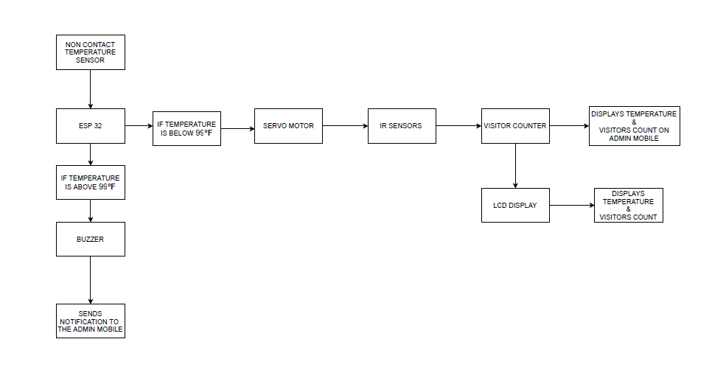
BLOCK DIAGRAM

Slide 7
EXPLANATION
When our hand is at a part of NON CONTACT TEMPERATURE SENSOR then it senses and goes to the ESP 32 microcontroller then if the temperature is below 99degree F then the condition is true and goes to the SERVO MOTOR then the servo motor gets activated and then it decides to open the gate. If the condition is false , that is if the temperature is above 99 degree F then, as it is further connected to BUZZER then the buzzer gets activated and gives us beep alarm.
This is for the temperature sensing of door opening or giving an alarm. And now lets see for the visitor counting system and displaying on device and linking it to the mobile application which gives us notifications.

Slide 8
EXPLANATION
So now after the part of temperature scanning and gate opening its time for the sensing the visitors which leads us to the VISITOR COUNTER. Now continuing from the servo motor we have our IR SENSORS where they lead us to scan the visitors as IR means INFRARED which can have an ability to count the persons who are entering or leaving the door or gate. Then after we have our LCD DISPLAY. Which is used to display the temperature and the visitor count. Where we can have a quick glance over the output.
So this can have a mobile application which links to the ESP 32 MC where we can have a collected data output systematically. This is how our AUTOMATED COVID TEMPERATURE BASED GATE OPENING AND VISITOR COUNTER SYSTEM works.

Slide 9
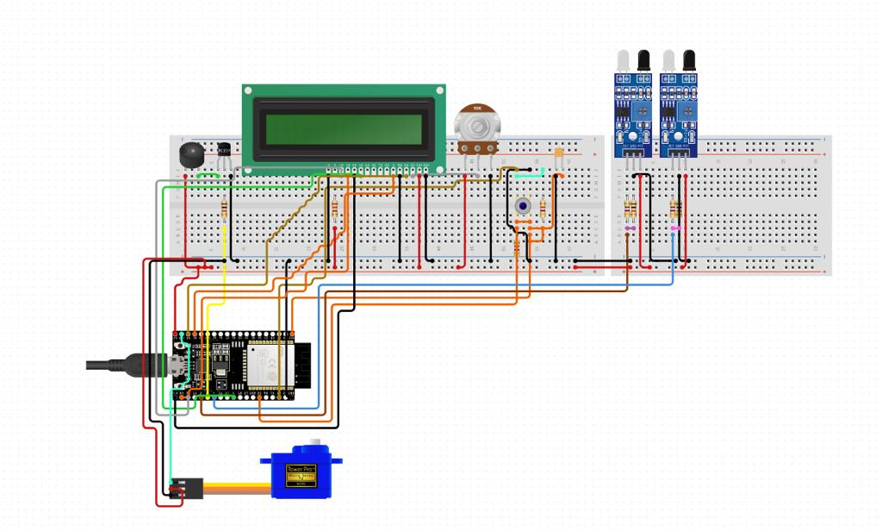
CIRCUIT DIAGRAM

Slide 10
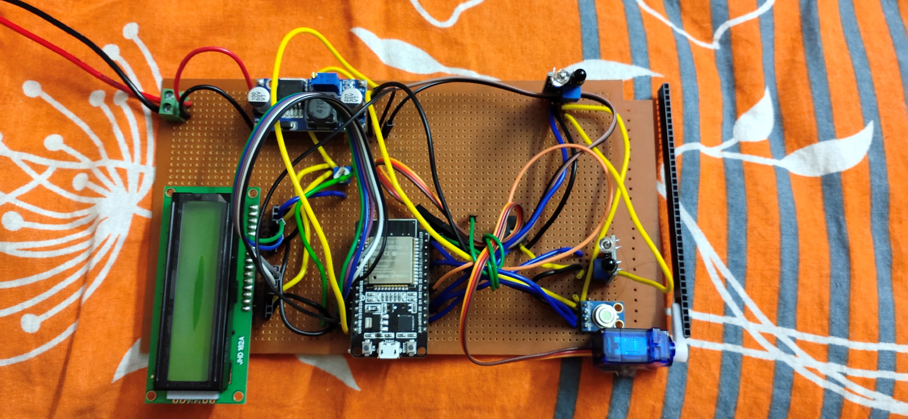
REAL PROJECT

Slide 11
ADVANTAGES
Easy to Implement near any existing entries.
Helps to maintain COVID Norms, by restricting the persons with high temperature.
It can replace thermal guns.
Easy configuration and setup process
On-board or cloud data reporting to shield from future liability.
This is done at low cost and very economical.
We are having a IOT based application so we can monitor from our android phones itself.

Slide 12
ADVANTAGES
Temperature can be scanned so that when we use at hospital premises, we can have healthy and safe roaming of visitors.
This project has a capability of counting number of visitors or persons that crossed the gate or the entrance or the exit. So that we can have a real time monitoring.

Slide 13
LIMITATIONS
The personnel are not well trained on using temperature scanner devices.
There is human error in reading values.
Manual scanning system is not suitable for large crowds.
Can be temporarily affected by frost, moisture, dust, fog, smoke or other particles in the air.
By this man power can be reduced so that employment shortage will occurs.
Distance can affect the IR scanner(temperature).
Allow only Low Temperature (Below 98.5F) person to enter the Premises.

Slide 14
APPLICATIONS
It helps in following the covid norms near:
schools, colleges and educational institutions.
Railway stations, Bus stations and Airports.
Restaurants and Hotels.
public gathering areas.
Public meetings.

Slide 15
CONCLUSION
An effective solution to ensure covid -19 safety compliance is presented in it.
It relies on widely available sensors to make a low cost, easily configurable and customized set up.
And it is a non contact approach which reduces the spreading of disease between people.

Slide 16
THANK YOU!

